Slide 1

HOSPITAL MANAGEMENT
SYSTEM
- ABHISHEK RAWAT 11704268
- TOGI KIRAN KUMAR 11704493
- AKASH SINGH 1170
- SAMYAK JAIN 11704214

Slide 2
CONTENT

Slide 3
Aim:

Slide 4
MODULE
RESPONSIBLE PERSONS

Slide 5





HOME PAGE

Slide 7

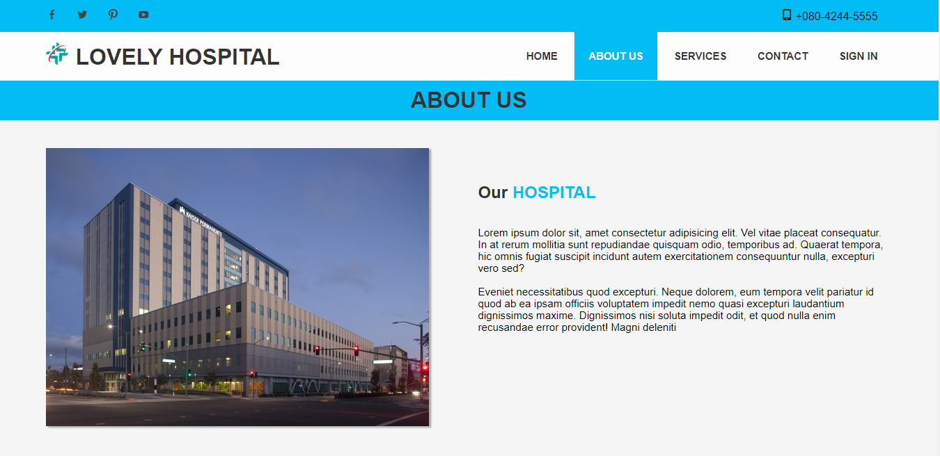
ABOUT US PAGE

Slide 9

SERVICES PAGE

Slide 11
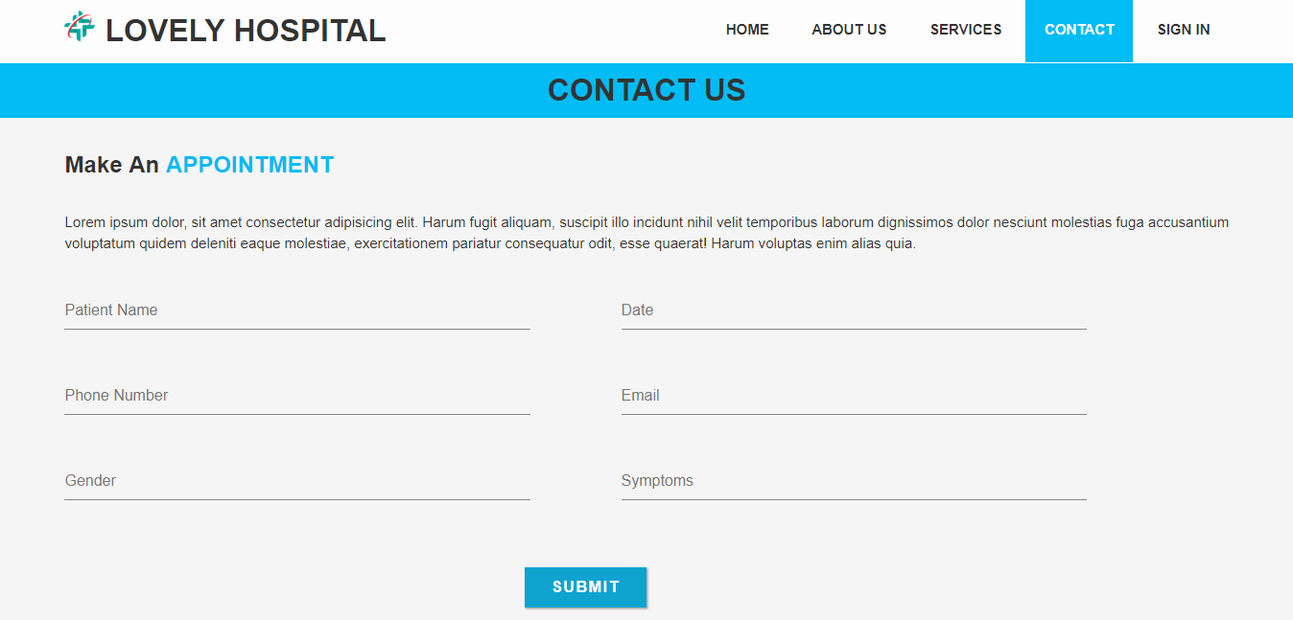
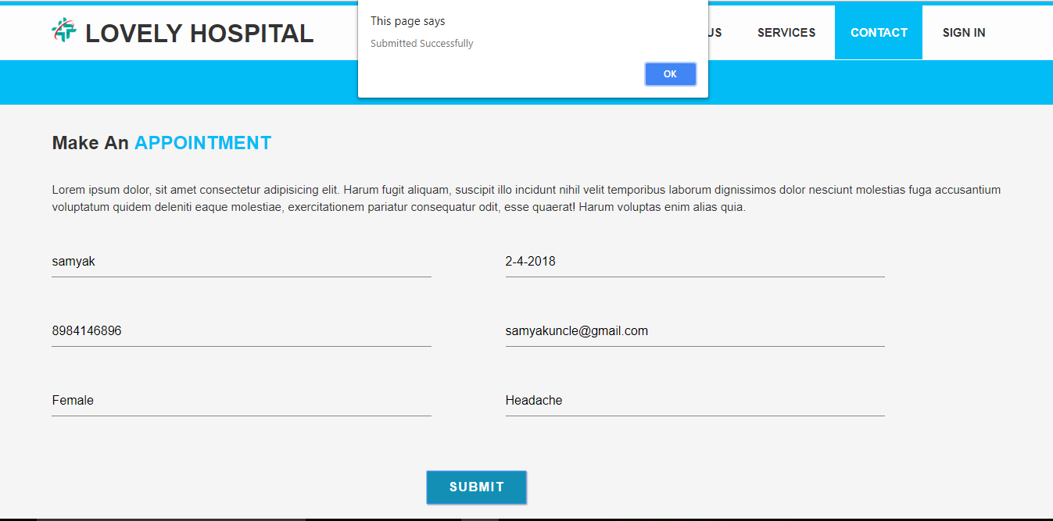
CONTACT PAGE

Slide 13
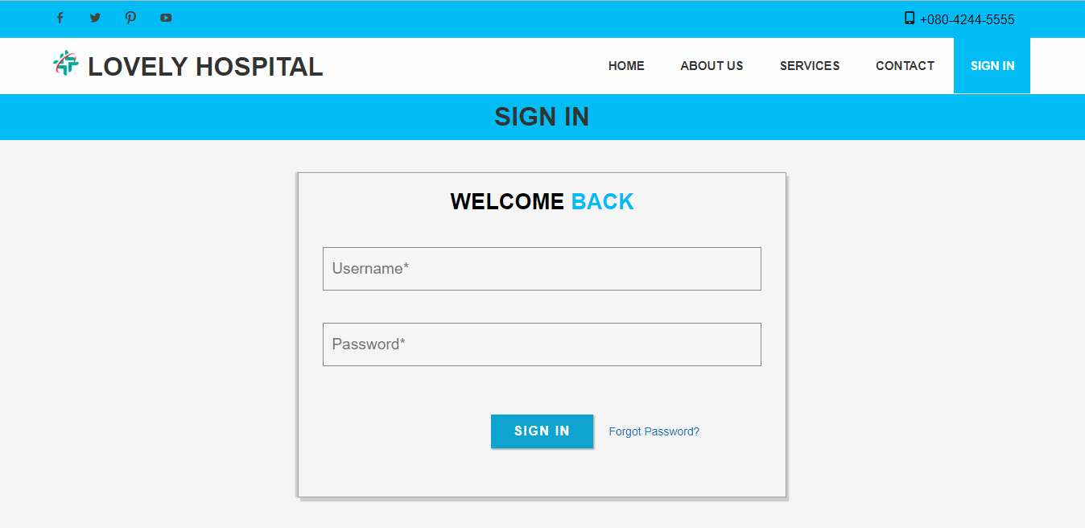
SIGN IN PAGE

Slide 14
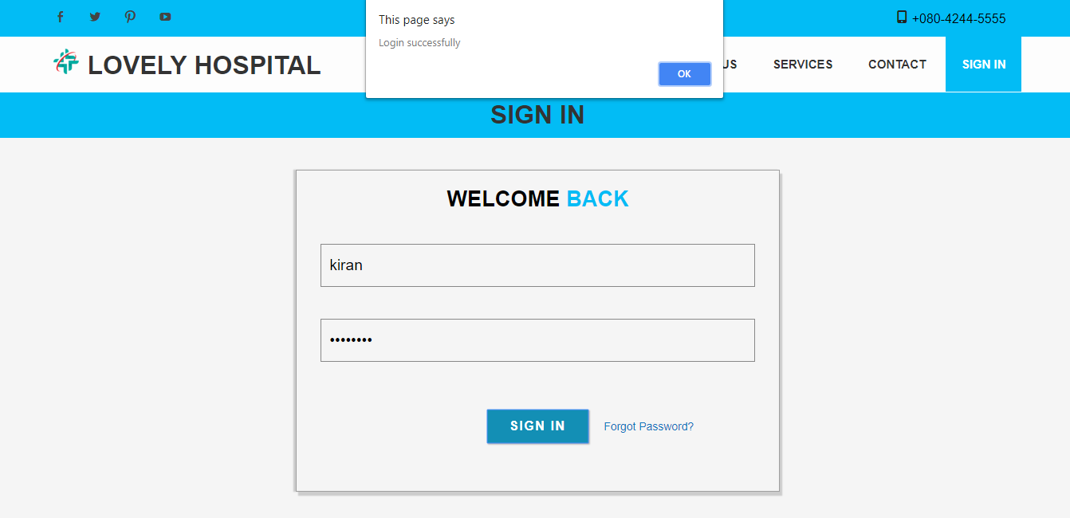
ADMIN SIGN IN

Slide 16
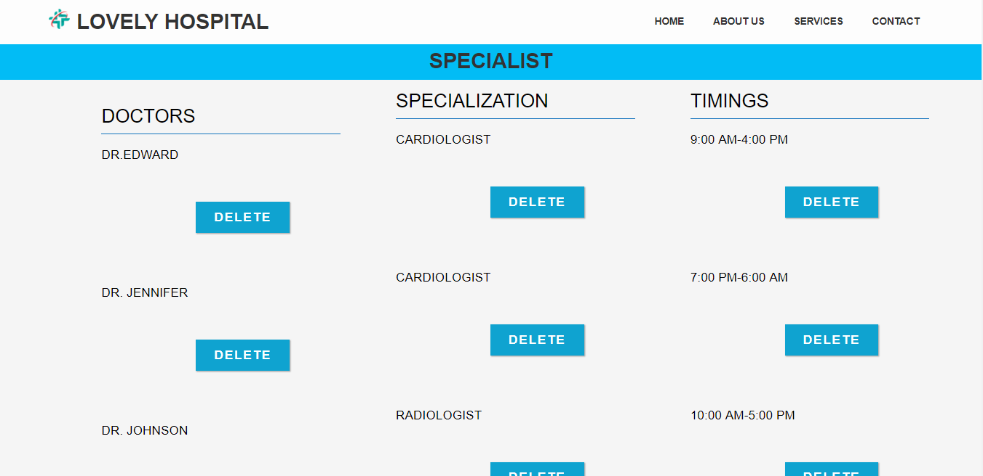
AVAILABILITY

Slide 18
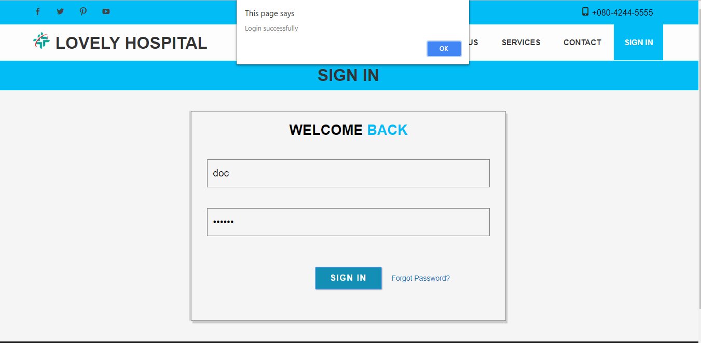
DOCTOR SIGN IN

Slide 20
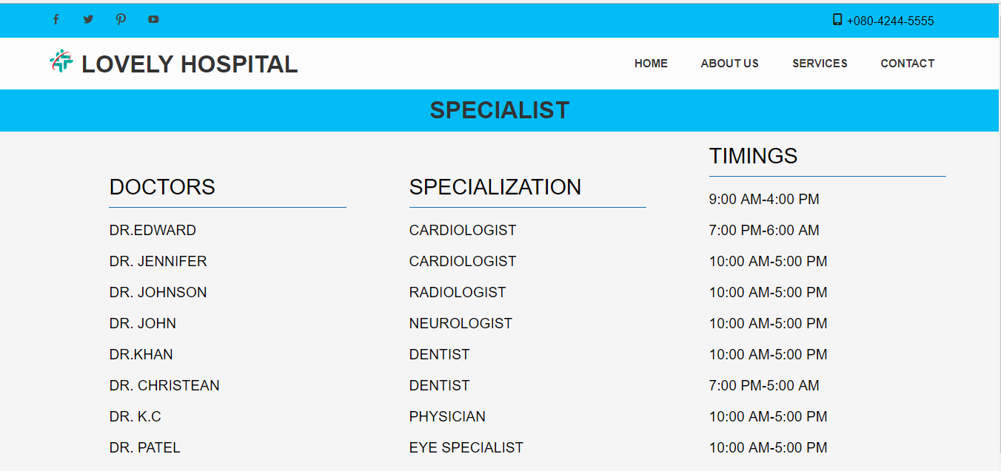
AVAILABILITY

Slide 22
